Slide 1
Computer Vision A glimpse to the future
Amit Aalok

Slide 2
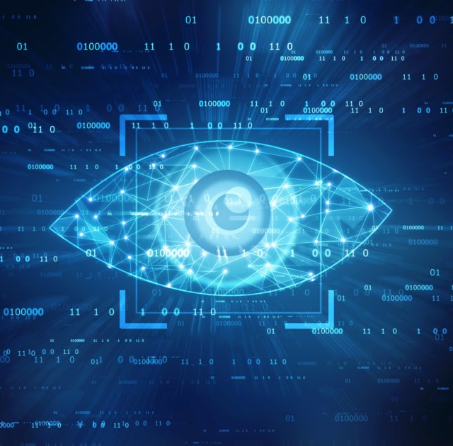
The What How And Why
What is Computer vision. Where'd it come from
How does it work
Why you should care

Slide 3
Two Content Layout with Table
First bullet point here
Second bullet point here
Third bullet point here
Class | Group 1 | Group 2
Class 1 | 82 | 95
Class 2 | 76 | 88
Class 3 | 84 | 90

Slide 4
Title and Content Layout with SmartArt
Step 1 Title
Step 2 Title
Task description
Task description
Task description
Task description
Task description
Task description
Task description
Step 3 Title
Task description
Task description
Step 4 Title
Task description
Task description

Slide 5
Add a Slide Title - 1

Slide 6
Add a Slide Title - 2

Slide 7
Add a Slide Title - 3

Slide 9
Add a Slide Title - 4

Slide 10
Add a Slide Title - 5

